Slide 1
Practical Messaging
A 101 guide to messaging
Ian Cooper
Twitter: ICooper

Slide 2
Who are you?
Software Developer for over 20 years
Worked mainly for ISVs
Reuters, SunGard, Misys, Huddle
Worked for a couple of MIS departments
DTI, Beazley
Microsoft MVP for C#
Interested in OO design
Interested in Agile methodologies and practices
No smart guys
Just the guys in this room

Slide 3
Day Two Agenda
Event Driven Collaboration
Reliability
Order
Consumers
Documentation
Middleware & Frameworks Discussion (Separate Decks)

Slide 4
Day Two

Slide 5
3.1 Event Driven Collaboration
Event Carried State Transfer

Slide 6
Getting work done in a Monolith
{POST: New Booking}
{Call Channels}
{Call Payment Provider}
API
Presentation
{Create New Booking}
{Take Payment}
{Inform Channels}
Housekeeping
Channel Manager
Direct
Bookings
Credit Card
Payments
Accounts
{Ready Housekeeping}
{Update Booking}
{Get CC Details}
{Create Account Objects}
{Write Housekeeping}
Domain
{Write New Booking}
ORM
{Get Channels}
Data
{Read/Write Rows}
Db
Notes:
In a typical monolithic application, we might divide up our system into three layers.
Presentation: The widgets, in this case our HTTP API, but might it might have been server-side rendered HTML etc.
Domain: The application and domain logic
Data: Access to our persistent storage
Let us imagine that we have a request for a direct booking on account. To service this request, we would probably call some application logic in a service/command in direct bookings. The application logic there would load the data we needed to complete the operation, so the account details with the credit card information, so that we could then take a credit card payment. In turn we would then update the direct booking and probably call Housekeeping and Channel Manager to update their records of the number of available rooms.
Now, there is a lot going on, but we never had to worry about how we accessed the data at any step, we just read or wrote it to the db

Slide 7

Event Driven Architecture
“Messaging over a lightweight message bus such as RabbitMQ”
Fowler and Lewis
Direct
Bookings
Credit Card
Payments
Accounts
Housekeeping
Channel Manager
API
API
API
API
API
Db
Db
Db
Db
Db
Consumer has no notion of producer, just a topic on tbe broker
Channels subscribes to a ‘topic’ on the broker
Broker
Notes:
A service publishes an event to a broker – usually using a topic or similar identifier
A consumer subscribes to that topic on the broker and receives messages
The channel usually offers guaranteed at least once delivery avoiding the issue of temporal coupling

Slide 8

Event Driven Architecture
Direct
Bookings
Credit Card
Payments
Accounts
Housekeeping
Channel Manager
API
API
API
API
API
?
Db
Db
Db
Db
Db
Broker
Notes:
We raise a booking event and it travels down the bus before being opened by the credit card payments service
The credit card payment service reads the message, that a booking has been made, and now needs to process the payment. But how?
Does it call the Direct Bookings API to get hold of the data?
- If we do this we are back where we started, and the

Slide 9

I have a local cache of the other services data, that I can use to service requests
Credit Card
Payments
Push
Not
Pull
API
Accounts
Reference
Cache
Credit Card
Payments
API
Payments
Db
I receive a Document Message that contains the data required to process event
Payments
Db

Slide 10
3.1.1 Pipes and filters
Orchestration and Choreography

Slide 11
What is a microservice?
SOA is focused on business processes. These processes are performed in different steps (also called activities or tasks) on different systems. The primary goal of a service is to represent a “natural” step of business functionality. That is, according to the domain for which it’s provided, a service should represent a self-contained functionality that corresponds to a real-world business activity.
Josuttis, Nicolai M.. SOA in Practice: The Art of Distributed System Design . O'Reilly Media. Kindle Edition.
Notes:
Whilst this is SOA advice, we are taking the view that microservices are just SOA 3.0, and as such, most of the best practice still applies
The key here is to understand that we want service alignment with a business process or activity. Whilst services offer us benefits such as fault-tolerance through isolation, that is not the thrust of this workstream. Instead this workstream is looking at how microservices improve our productivity, when we get alignment between a service and a business process.
We amplify this point in the next slide, which talks about the entity service anti-pattern

Slide 12




Inbox
Work
Outbox
Async
Sync
Async

Slide 13
Inbox
Uses an async HTTP API – 202 Accepted
{POST: New Booking}
Direct Bookings
API
Process
In-Process
Bookings Db
Outbox
Uses middleware
Broker

Slide 14
Pipeline
Inbox
Process
Outbox
Inbox
Process
Outbox

Slide 15

Choreography

Slide 16
Event-Oriented
Choreography
{POST: New Booking}
Direct Bookings
Accounts
Credit Card
Payments
API
API
API
Credit Card Payments can use the enriched information to process
Bookings Db
Accounts Db
Credit Card Db
We send the booking message to Account to enrich it.
Broker
Notes:
We might have two customers: guest accounts, that include the payment details in their booking, and and subscriber accounts that have already registered their payment details.
We can turn this into one ’booking made’ request by passing it through a pipeline, so that when a subscriber account booking is made, which has no payment data, we enrich the message with the missing data before passing it downstream to the credit card service. This helps us keep services from needing to make a request to the service that originates the data, by including the missing values in the message.
Pipes and Filters is choreography as there is no central controller. Remember when we talked about avoiding ‘entity services’. Often we will have a flow with a number of process steps. The message mimics this flow, passing through each process as the customer’s request is satisfied. Think of how pre-automation a customer order might have moved from one department to another
It uses events (perhaps document messages in this case) and has low temporal coupling.
Compensation is handled by raising an event that indicates an error, and assuming other services will take reversing action i.e. cancel a booking if a payment fails
There is explicitly no central control, as this adds behavioral coupling, although we can ‘wire tap’ the flow of messages to observe the flow.

Slide 17
{POST: New Booking}
Inbox
Direct Bookings
Credit Card
Payments
API
API
Process
Process
Bookings Db
Credit Card Db
Outbox
Inbox
Outbox
Broker

Slide 18
{POST: New Booking}
Inbox
Direct
Bookings
Accounts
Credit Card
Payments
Housekeeping
Channel Manager
API
API
API
API
API
Process
Process
Process
Process
Process
Db
Db
Db
Db
Db
Outbox
Inbox
Inbox
Inbox
Inbox
Outbox
Outbox
Outbox
Broker
Notes:
We can move the flow of a whole consumer

Slide 19
Event-Oriented
Choreography (Wire Tap)
{POST: New Booking}
Direct Bookings
Accounts
Credit Card
Payments
API
API
API
Bookings Db
Accounts Db
Credit Card Db
Broker
Tracking
Tracking Db
We can tap the communications flowing through the broker to monitor work
API
Notes:
We might have two customers: guest accounts, that include the payment details in their booking, and and subscriber accounts that have already registered their payment details.
We can turn this into one ’booking made’ request by passing it through a pipeline, so that when a subscriber account booking is made, which has no payment data, we enrich the message with the missing data before passing it downstream to the credit card service. This helps us keep services from needing to make a request to the service that originates the data, by including the missing values in the message.
Pipes and Filters is choreography as there is no central controller. Remember when we talked about avoiding ‘entity services’. Often we will have a flow with a number of process steps. The message mimics this flow, passing through each process as the customer’s request is satisfied. Think of how pre-automation a customer order might have moved from one department to another
It uses events (perhaps document messages in this case) and has low temporal coupling.
Compensation is handled by raising an event that indicates an error, and assuming other services will take reversing action i.e. cancel a booking if a payment fails
There is explicitly no central control, as this adds behavioral coupling, although we can ‘wire tap’ the flow of messages to observe the flow.

Slide 20
Event-Oriented
Choreography (Errors)
{POST: New Booking}
Direct Bookings
Accounts
Credit Card
Payments
API
API
API
Which might in turn raise an event to notify the customer, using their email etc.
If we cannot take the payment, we raise an error event
We can take appropriate action like suspending the booking
Bookings Db
Accounts Db
Credit Card Db
Broker
Notes:
We might have two customers: guest accounts, that include the payment details in their booking, and and subscriber accounts that have already registered their payment details.
We can turn this into one ’booking made’ request by passing it through a pipeline, so that when a subscriber account booking is made, which has no payment data, we enrich the message with the missing data before passing it downstream to the credit card service. This helps us keep services from needing to make a request to the service that originates the data, by including the missing values in the message.
Pipes and Filters is choreography as there is no central controller. Remember when we talked about avoiding ‘entity services’. Often we will have a flow with a number of process steps. The message mimics this flow, passing through each process as the customer’s request is satisfied. Think of how pre-automation a customer order might have moved from one department to another
It uses events (perhaps document messages in this case) and has low temporal coupling.
Compensation is handled by raising an event that indicates an error, and assuming other services will take reversing action i.e. cancel a booking if a payment fails
There is explicitly no central control, as this adds behavioral coupling, although we can ‘wire tap’ the flow of messages to observe the flow.

Slide 21
Event-Oriented
Choreography (Routing Slip)
{POST: New Booking}
Direct Bookings
Accounts
Credit Card
Payments
API
API
API
Bookings Db
Accounts Db
Credit Card Db
We send the booking message to Account to enrich it.
Credit Card Payments can use the enriched information to process
Notes:
With a routing slip, we do not return to the broker, but we pass between point-ot-point queues, using a route contained in the message. Misunderstood, and explicitly and alternative to a broker based architecture like RMQ

Slide 22

Orchestration

Slide 23
Command-Oriented
Processor Manager
Db
1:Saga makes a booking
2:Saga gets account details
3:Saga sends enriched booking message
Direct Bookings
Accounts
Credit Card
Payments
API
API
API
Orchestration
Bookings Db
Accounts Db
Credit Card Db
Broker
Notes:
This is orchestration, because there is a central controller of the saga. We increase the behavioral coupling over Choreography because we use command->document and not events.
In return we get:
Increased visibility of the operation and the ability to manage
We send a command to book and we add a private reply queue and correlation id, then save the workflow.
Booking makes the booking and returns the id of our booking to us
We wake the workflow indicated by the correlation id and look up the next step
We send a command to accounts to ask for the credit card details and give it a reply queue, then save the workflow
Accounts adds account details to the booking and returns it to us
We wake the workflow indicated by the correlation id and look for the next step
We send a command to payments to pay for the room, and give it a reply queue, then save the workflow
Payments takes the payment and returns the result to us
We wake the workflow and complete it

Slide 24
Processor Manager
1:Saga cancels booking
1:Saga emails customer
1:Saga gets error response
Direct Bookings
Accounts
Credit Card
Payments
API
API
API
Compensation (Error)
Bookings Db
Accounts Db
Credit Card Db
Broker
Notes:
We also get a very explicit compensation flow i.e. When something goes wrong we can raise an exception and have it propagate to reverse the flow. Because the workflow has a request-reation flow, we know that the action has been reversed because we receive confirmations from all the microservices that we have reversed the transaction. Thus we get guarantees around reversal

Slide 25


2:We reserve the booking
Processor Manager
1:User
makes booking
3:User
checks out
4:User
Times Out
Direct Bookings
Accounts
Credit Card
Payments
API
API
API
Reservations
Bookings Db
Accounts Db
Credit Card Db
Broker
Notes:
We might decide that we don’t want to hold the booking of ever, particularly if the use has a number of manual steps to complete and the process manager is controlling that flow.
The user makes the booking, and puts it in their cart. Then they check out, and then they pay for it. We don’t want someone else to take their booking whilst they are checking out, but we don’t want them to walk away leaving us with an unsold room.
The answer is to reserve the room for a period of time, and timeout when that limit is reached, reversing the transaction

Slide 26
Choreography
?
Orchestration

Slide 27
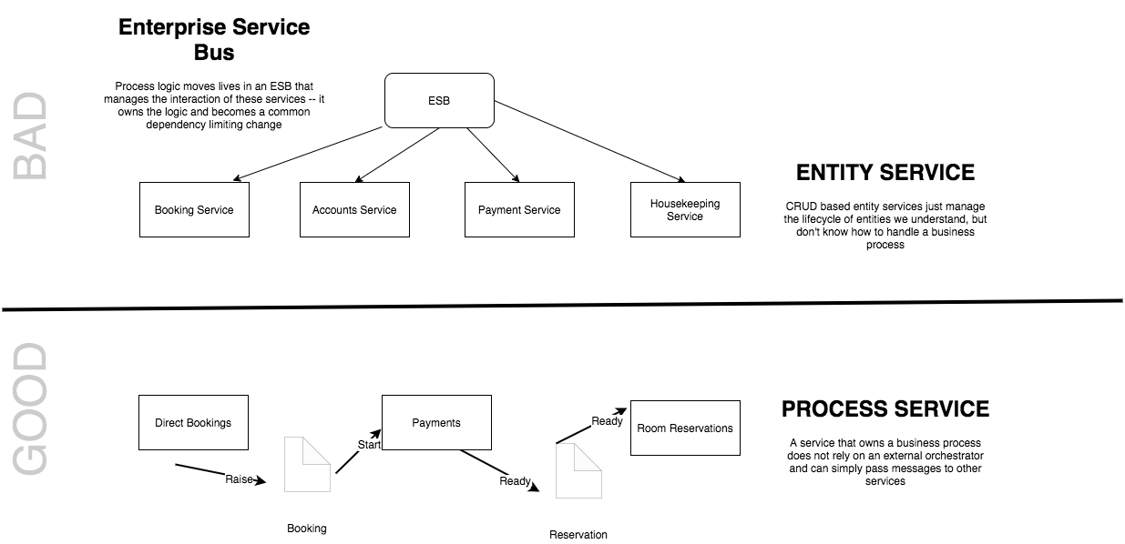
Smart Endpoints and Dumb Pipes
Notes:
“The microservice community favours an alternative approach: smart endpoints and dumb pipes. Applications built from microservices aim to be as decoupled and as cohesive as possible - they own their own domain logic and act more as filters in the classical Unix sense - receiving a request, applying logic as appropriate and producing a response.
The problem with the saga, as opposed to choreography is that it moves logic into the saga, so the endpoints become dumber, at risk of becoming entity services controlled by an orchestrator
”

Slide 28
3.1.2 Event carried state transfer
=Reference Data

Slide 29
GET \booking\12345 HTTP 1.1
---
Cache-Control: max-age=30
Last-Modified: Fri 20 April 2019 09:00 GMT
ETag: “33a64df551425fcc55e4d42a14879”
Reference Data
Pat Helland
Direct
Bookings
API
Outside Data
Services are Autonomous
Immutable, stale, versioned
Boundaries are Explicit
Single Writer
Db
Booking.Created.Event
Message-Id: aa95b387-a17f-4907-a1d8-e597c322bfc6
Correlation-Id: d060cb3f-ec71-4257-b5c8-819d1a9ca6cb
Format: application/json
Schema: 1.1
{ items : [Booking {… “Version” : “1”}]}
Inside Data
Share Schema not Type

Slide 30
Reference Data is Highly Cacheable
GET /booking/12345 HTTP 1.1
If-Modified-Since: Fri 19 April 2019 09:00 GMT
Direct
Bookings
API
Browser
Forward
Proxy
Reverse
Proxy
Single Writer
C ache
C ache
C ache
Db
The Web scales by caching

Slide 31
Query By
Event Carried
State Transfer
Event:
{ [booking made: {
date:05 JUN
…
}}
Martin Fowler
Accounts
Credit Card Payments
Read Customer info
Notify Downstream Consumers
Worker
Write Payment
Details
Accounts Ref Db
CC Payments Db

Slide 32
Messaging has Bulkheads
Accounts
Credit Card
Payments
API
API
Accounts Db
Accounts
Reference Cache
Credit Card Db
Broker
Notes:
Messaging systems trade consistency for availability

Slide 33
Reference Data is Protocol Agnostic
Accounts
Credit Card
Payments
API
API
FTP
Accounts Db
ETL
Accounts
Reference Cache
Credit Card Db
ATOM
ECST

Slide 34
Types of Reference Data
Operand Data (e.g. Product Catalog)
Shared Collections (e.g. Customer, User)
Historic Artefacts (e.g. Order History)
Notes:
Three types:
Operands
When we talk to another service we communicate two things:
operator - a behavior that I want you to enact
operand - the data I want you to use to enact that
An operand has to make sense to the receiver, and so the receiver may need to publish information that can be used as operands - this is the ‘reference data’
Examples: Product Catalog
Historic Artefacts
A snapshot of our data, commonly used for reporting, analysis etc. Often rolled up.
Shared Collection
Data that all services tend to rely on such as Customers or Users
Differs from operands in that we may process dependent on it, not just use it to formulate requests to another system
We don’t want to request this data on demand, it’s too expensive, so we want a local cache of the data
We may convert the data into a more usable local form, but we don’t own the data so we need to avoid the risk of changing it. We may for example shred it into tables, or ignore data that we do not depend on.

Slide 35
Would I cache you as Request Data?
We cache Outside Data not Inside Data!
Reference Data does not know the rules!
Notes:
Would I cache you as Request Data?
We are trying to prevent you making a request. Another way to do this is to cache the results of a GET. To cache that data it has to be suitable ‘Outside Data’ – versioned and immutable, and a stable contract, not the implementation details. But it also has to be suitable for caching? How fast does it go stale? Will every call result in a different result set because of temporal concerns? In addition, note that I cache, not the other services internal data but Outside Data. A mistake here would be to replicate the other services internal data between two services as reference data. In particular, if I share internal data and need to share the rules to interpret it, then I couple that other microservice into my implementation details.

Slide 36
Query by Event Carried State Transfer
Decoupled
Autonomous
The Good
Low Latency/Pre-Calculated
Fault Tolerant
Notes:
Decoupled: Queries are now local, we are decoupled from other services
Autonomous: We don’t functionally integrate with other services, nor know their implementation details.
Lower latency network calls, pre-calculated results
Fault Tolerance: We are a bulkhead to failure, but also we cope better with resource constraints through the use of decoupled invocation

Slide 37
Query by Event Carried State Transfer
Eventual Consistency
The Bad
Replication of Data
Synchronization
Notes:
Eventual Consistency: we are stale, but this may not matter if we are ‘task’ oriented
Replication of Data: We are creating a lot of copies of our data. Storage is cheap? Although if it doubles every year…
Synchronization: It’s a hard problem, how do we ensure source and sink are the same?

Slide 38
4. reliability

Slide 39
4.1 guaranteed delivery
At Least Once

Slide 40
Client
Master
Mirror
A
B
myQueue
2
myQueue
1
3
2
C
Client
RMQ Cluster
3
Mirror
myQueue
40
Notes:
The problem with a distributed transaction
1: I try to write to the queue
2: The queue creates a transaction and writes to all the other queues in the cluster. Note that this might be in a different AZ
3: The queue then responds when the message has been written to the queue
What happens on failure to write to a node? MoM defined. RMQ for example will not guarantee, better to use publisher confirms that send you an ack when the message is written to the queue (persistent) or when it is consumed (non-persistent) and then resend when failed. Kaka lets you choose how many of your nodes is success

Slide 41
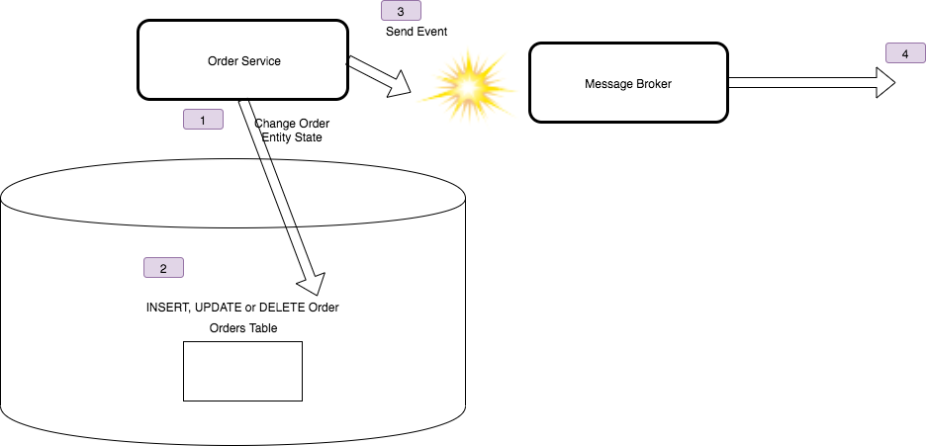
Correctness Problem

Slide 42
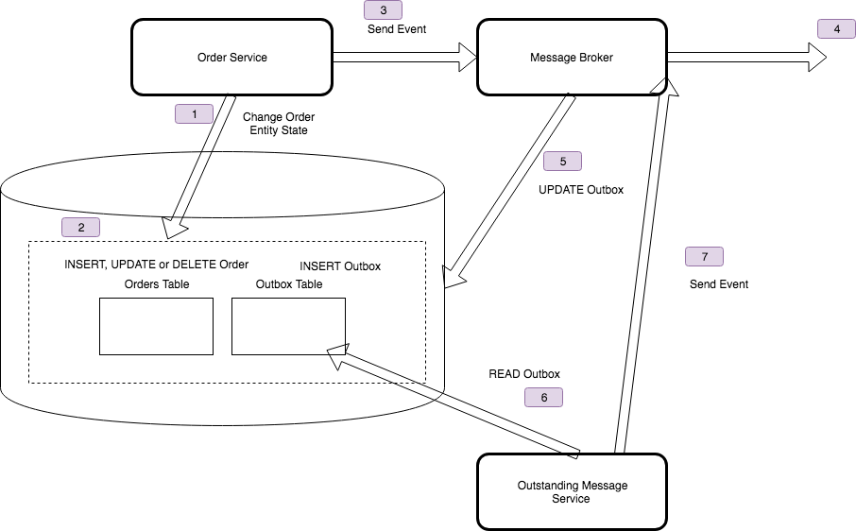
Outbox Pattern

Slide 43
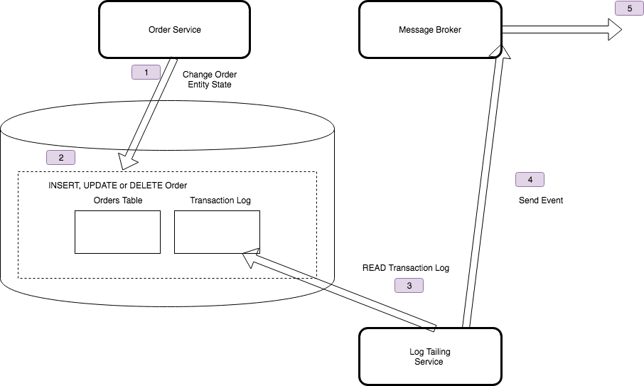
Log Tailing

Slide 44
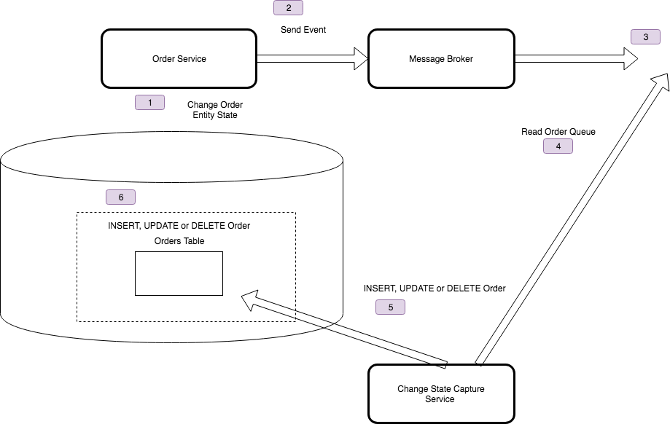
State Change Capture

Slide 45
4.2 At least once, Exactly once

Slide 46
Message
A
Broker
Ack
Message
Ack
Notes:
How can you ensure that messages are received successfully?
For each message retrieved by a receiver an acknowledgement is sent back to the message sender. If this acknowledgement is not received after a certain time frame, the message is resent.
We may not know if the acknowledgement itself failed, but the original send succeeded.

Slide 47
Message
A
A
Ack
Message
Store Message
Check for Message having been seen
Notes:
So we need to have an idempotent receiver that can reject messages already seen, or is not affected by re-application.
We could also ensure that logically we could re-apply the message

Slide 48
Message
A
A
Ack
Message
Store Message
Check for Message having been seen
Notes:
We can combine guaranteed delivery and at-least once to ensure that messages will be delivered once.

Slide 49
4.3 Series and Discrete

Slide 50
Shared Queue
Accountss
Credit Card
Payments
API
API
The message is deleted from the queue once actioned
Credit Card Db
Accounts Db
Accounts
Reference Cache
Outbox
Inbox
Replay must use the Outbox
De-duplication requires the Inbox
Broker
Notes:
Shared Message Queue or Shared Message Log
All distributed messaging systems store their data, replicated across nodes in a cluster, using some form of Db
In a Shared Message Queue, that storage has queue semantics, we can lock an item of the front of the queue, so as to allow other readers to skip past it, retrieve an item from the queue, and either unlock or delete the item at the end. We usually unlock for a failure to process, and delete when done. So our storage is mutable, once we have processed an item, we have changed the queue.
In a message log, the storage has append-only log semantics. We maintain an index to the next item for a consumer to read, in order, and we can manage those indexes in the distributed system to allow multiple consumers to traverse the same queue together, but we never alter the queue. So after we finish processing a message we just increment the index.
We use more storage for the log, because we are not deleting messages, but we gain the ability to reset our index and replay the messages.
With a shared queue, replay depends on an outbox or inbox
We started buy using a shared message queue and listening for downstream events
We solved ordering by using a sequential version number and resequencing when 'out-of-order'
Ordering creates a problem for consumers
We could add a sequence number to enforce ordering
[Does not work with competing consumers
We can create partitions to allow competing consumers to work
All events need to be under one topic
We may have events for a lot of entities. How do we partition?
Has limitations. How do I replay, so that I can spin up a new service (big problem in QA envirionments)?
We had an 'Outbox' but still, we needed to write code to resend and ensure other consumers discarded duplicates (i.e. have we seen this message or this version of the data for this id)
We then moved to using a shared message log (in our case GES, but Kafka is probably the default choice for many)
Arguably this is Active Service over Event Carried State Transfer, because like an ATOM-feed we pull the 'current' state by reading an immutable, read-only feed to populate our cache

Slide 51
Event Types
Discrete
Independent
Report State Change
Actionable
Series
Time Ordered
Context Partitioned
Report Condition
Analyzable

Slide 52
Series
Discrete
PUSH
PULL
Context
Offset
Stateless
Handler
Stateful
Partition
Processor
PUSH requires an open socket, so not used with Cloud Infrastructure brokers, who use PULL in this context but still have a stateless handler. Adds latency to notification depending on polling interval

Slide 53
Message Log
Accounts
Credit Card
Payments
API
API
Replay just resets the queue index for next
Credit Card Db
Accounts Db
Accounts
Reference Cache
The message remains in the queue
Outbox
Inbox
Broker
Outbox only needed if required for correctness
Inbox only needed if log does not support once-only
Notes:
Shared Message Queue or Shared Message Log
All distributed messaging systems store their data, replicated across nodes in a cluster, using some form of Db
In a Shared Message Queue, that storage has queue semantics, we can lock an item of the front of the queue, so as to allow other readers to skip past it, retrieve an item from the queue, and either unlock or delete the item at the end. We usually unlock for a failure to process, and delete when done. So our storage is mutable, once we have processed an item, we have changed the queue.
In a message log, the storage has append-only log semantics. We maintain an index to the next item for a consumer to read, in order, and we can manage those indexes in the distributed system to allow multiple consumers to traverse the same queue together, but we never alter the queue. So after we finish processing a message we just increment the index.
We use more storage for the log, because we are not deleting messages, but we gain the ability to reset our index and replay the messages.
With a shared queue, replay depends on an outbox or inbox
We started buy using a shared message queue and listening for downstream events
We solved ordering by using a sequential version number and resequencing when 'out-of-order'
Ordering creates a problem for consumers
We could add a sequence number to enforce ordering
[Does not work with competing consumers
We can create partitions to allow competing consumers to work
All events need to be under one topic
We may have events for a lot of entities. How do we partition?
Has limitations. How do I replay, so that I can spin up a new service (big problem in QA envirionments)?
We had an 'Outbox' but still, we needed to write code to resend and ensure other consumers discarded duplicates (i.e. have we seen this message or this version of the data for this id)
We then moved to using a shared message log (in our case GES, but Kafka is probably the default choice for many)
Arguably this is Active Service over Event Carried State Transfer, because like an ATOM-feed we pull the 'current' state by reading an immutable, read-only feed to populate our cache

Slide 54
4.4 Compensation

Slide 55
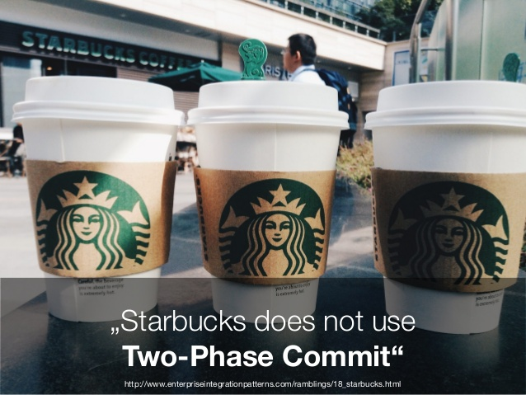
Notes:
The strategies discussed iffer from a traditional two-phase commit that relies on separate prepare and execute steps for each participant. In the Starbucks example, a two-phase commit would equate to having the customer wait at the cashier’s counter with money and the receipt until the drink is ready. Then, the money, receipt, and drink would change hands in one swoop. Neither the cashier nor the customer could leave until the transaction was complete.
Using such a two-phase-commit approach would certainly kill a coffee shop’s business because it would dramatically decrease the number of customers the shop could serve in a certain time interval. Although a two-phase commit can make life a lot simpler, it can also hurt the free flow of messages (and therefore scalability) because it requires the allocation of a stateful transaction resource across the flow of multiple, asynchronous actions. Starbucks follows an optimistic approach to optimize throughput in the “happy day” scenario, even though this results in a small loss when errors occur.
When amounts and stakes are larger, a pessimistic two-phase-commit approach is more appropriate (see Figure 1d). For example, when you purchase a home, an escrow company essentially acts as a transaction coordinator, offering a two-phase-commit service. The escrow company ensures that all required resources from all parties, such as funds, documents, and permits, are available before committing the transaction—that is, the purchase of the property. Once the transaction closes, all resources are consistently committed across all parties.

Slide 56
Compensation: Write Off
A
B
2: Handle Event
1: Raise Event
C
2: Application Exception
56
Notes:
Write-off
This is the simplest strategy: do nothing, or discard what you’ve done (see Figure 1a). This might seem like a poor plan, but in the reality of business, it might be acceptable. If the loss is small, building
an error-correction solution might be more expensive. Furthermore, it might slow down the flow of messages, which reduces system throughput.

Slide 57
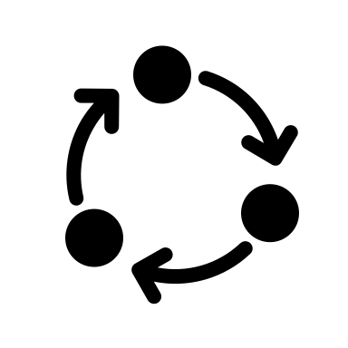

Compensation: Retry
A
B
2: Handle Event
1: Raise Event
3: Retry
4: Circuit Breaker
C
2: Application Exception
57
Notes:
Retry
When one operation out of a group of operations (or “transactions”) fails, you have essentially two choices: undo the ones that completed successfully or retry the one that failed. Retry is a plausible option if there’s a realistic chance that the retry will succeed (see Figure 1b). For example, if an external system is temporarily unavailable or an item is out of stock, a retry might be worthwhile. However, if a business rule was violated, it’s unlikely a retry will succeed.

Slide 58
Compensation: Compensating Event
A
B
2: Handle Event
5: Compensate
1: Raise Event
5: Compensate
C
2: Application Exception
4: Raise Compensating Event
58
Notes:
Compensating action
The obvious alternative to retrying failed operations is to undo already completed operations to return the system to a consistent state (see Figure 1c). Such compensating actions work best with monetary systems, where we can credit money already debited. But real life uses many other compensating actions. For example, we might call and ask a customer to ignore a letter that has been sent or to return a package that was sent in error.

Slide 59
Compensation: Process Manager
A
B
6: Compensate
5: Compensate
2: Handle Event
4: Raise Compensating Event
1: Raise Event
C
Process Manager
3: Application Exception
59

Slide 60
4.5 cap theorem

Slide 61
You can have at most two of these properties for any shared data system
Notes:
Created by Eric Brewer According to University of California, Berkeley computer scientist Eric Brewer, the theorem first appeared in autumn 1998.^{[6]} It was published as the CAP principle in 1999^{[7]} and presented as a conjecture by Brewer at the 2000 Symposium on Principles of Distributed Computing (PODC).^{[8]} In 2002, Seth Gilbert and Nancy Lynch of MIT published a formal proof of Brewer's conjecture, rendering it a theorem.
Consistency - A read is guaranteed to return the most recent write for a given client.
Availability - A non-failing node will return a reasonable response within a reasonable amount of time (no error or timeout).
Partition Tolerance - The system will continue to function when network partitions occur.

Slide 62
Master
Mirror
A
B
myQueue
myQueue
1
1
2
C
2
3
3
1
Mirror
myQueue
2
3
62
Notes:
The problem with a distributed transaction
1: I try to write to the queue
2: The queue creates a transaction and writes to all the other queues in the cluster. Note that this might be in a different AZ
3: The queue then responds when the message has been written to the queue
What happens on failure to write to a node? MoM defined. RMQ for example will not guarantee, better to use publisher confirms that send you an ack when the message is written to the queue (persistent) or when it is consumed (non-persistent) and then resend when failed. Kaka lets you choose how many of your nodes is success

Slide 63
Master
Mirror
A
B
myQueue
myQueue
1
1
2
C
2
3
3
4
4
1
Mirror
myQueue
4
63
Notes:
The problem with a distributed transaction
1: I try to write to the queue
2: The queue creates a transaction and writes to all the other queues in the cluster. Note that this might be in a different AZ
3: The queue then responds when the message has been written to the queue
What happens on failure to write to a node? MoM defined. RMQ for example will not guarantee, better to use publisher confirms that send you an ack when the message is written to the queue (persistent) or when it is consumed (non-persistent) and then resend when failed. Kaka lets you choose how many of your nodes is success

Slide 64
Forfeit Partitions
Notes:
Forfeit the ability to cope with a network partition. How is this possible? We don’t distribute i.e. an RDBMS running on a single server, or in a cluster with 2-Phase Commit for consistency.
Assumption is that we are co-located in a rack and network partitions are rare and can be retried successfully within a timeout; or the server is on fire and we don’t care

Slide 65
Unavailable
Unavailable
A
B
myQueue
myQueue
1
1
C
1
Unavailable
myQueue
65
Notes:
The problem with a distributed transaction
1: I try to write to the queue
2: The queue creates a transaction and writes to all the other queues in the cluster. Note that this might be in a different AZ
3: The queue then responds when the message has been written to the queue
What happens on failure to write to a node? MoM defined. RMQ for example will not guarantee, better to use publisher confirms that send you an ack when the message is written to the queue (persistent) or when it is consumed (non-persistent) and then resend when failed. Kaka lets you choose how many of your nodes is success

Slide 66
Forfeit Availability
Notes:
Make minority partitions unavailable.
Distributed databases tend to use this approach. Tend to work with majority consensus protocols.
Rabbit MQ is here as the Mnesia database works this way.

Slide 67
Master
Mirror
A
B
myQueue
myQueue
1
1
2
C
2
3
3
4
4
1
Unsynchronized
myQueue
4
67
Notes:
The problem with a distributed transaction
1: I try to write to the queue
2: The queue creates a transaction and writes to all the other queues in the cluster. Note that this might be in a different AZ
3: The queue then responds when the message has been written to the queue
What happens on failure to write to a node? MoM defined. RMQ for example will not guarantee, better to use publisher confirms that send you an ack when the message is written to the queue (persistent) or when it is consumed (non-persistent) and then resend when failed. Kaka lets you choose how many of your nodes is success

Slide 68
Forfeit Consistency
Notes:
Serve data, even if it is stale. May be eventual consistency.
Web Caches
Expiration and Leases, Conflict Resolution (Etag, Last Modified, If-None-Match, If-Modified-Since)

Slide 69
Master
Mirror
A
B
myQueue
myQueue
1
1
2
C
2
3
3
4
4
1
Inconsistent
myQueue
4
69
Notes:
The problem with a distributed transaction
1: I try to write to the queue
2: The queue creates a transaction and writes to all the other queues in the cluster. Note that this might be in a different AZ
3: The queue then responds when the message has been written to the queue
What happens on failure to write to a node? MoM defined. RMQ for example will not guarantee, better to use publisher confirms that send you an ack when the message is written to the queue (persistent) or when it is consumed (non-persistent) and then resend when failed. Kaka lets you choose how many of your nodes is success

Slide 70
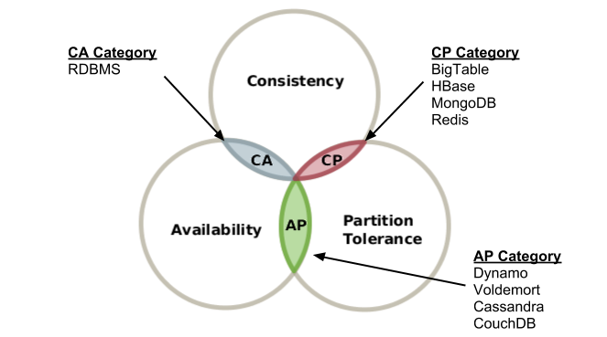

Slide 71
4.6 RabbitMQ and CAP Theorem

Slide 72
Client
Master
Mirror
A
B
myQueue
myQueue
C
Client
RMQ Cluster
Mirror
myQueue
Notes:
In an RMQ Cluster we have a leader node, and follower nodes. We want an odd number of nodes, 3 or 5 for examples, so that they can vote on who becomes the leader if the leader stops.
We replicate the exchange data out to all nodes in the cluster.
Clustering connects multiple machines together to form a single logical broker. Communication is via Erlang message-passing, so all nodes in the cluster must have the same Erlang cookie. The network links between machines in a cluster must be reliable, and all machines in the cluster must run the same versions of RabbitMQ and Erlang.
Virtual hosts, exchanges, users, and permissions are automatically mirrored across all nodes in a cluster.
Queues may be located on a single node, or mirrored across multiple nodes. A client connecting to any node in a cluster can see all queues in the cluster, even if they are not located on that node.
When a client connects to a queue, it always connects to the master, via the local node. The other queues only exist for the event of failure.
Each mirrored queue consists of one master and one or more mirrors. The master is hosted on one node commonly referred as the master node. Each queue has its own master node. All operations for a given queue are first applied on the queue's master node and then propagated to mirrors. This involves enqueueing publishes, delivering messages to consumers, tracking acknowledgements from consumers and so on.
Queue mirroring implies a cluster of nodes. It is therefore not recommended for use across a WAN (though of course, clients can still connect from as near and as far as needed).
Messages published to the queue are replicated to all mirrors. Consumers are connected to the master regardless of which node they connect to, with mirrors dropping messages that have been acknowledged at the master. Queue mirroring therefore enhances availability, but does not distribute load across nodes (all participating nodes each do all the work).
If the node that hosts queue master fails, the oldest mirror will be promoted to the new master as long as it synchronised. Unsynchronised mirrors can be promoted, too, depending on queue mirroring parameters.

Slide 73
Client
Master
Mirror
A
B
myQueue
myQueue
C
Client
RMQ Cluster
Master
myQueue
Notes:
In the event that there is a partition, then the partitioned node will decide that it is also a master. Thus this node is now out-of-sychronization i.e. has become inconsistent. As new messages are written to the exchange and published to attached nodes, they will not propogate to the other side of the partition.
By default we are AP, we have availability I can talk to both nodes in the event of a partition.
It is easy to see that we have sacrificed consistency in this instance.
If we publish to one node or the other, then we will not have those messages on both sides. If we have multiple clients of the queue i.e. competing consumers, we will not agree on what messages have already been processed i.e. we will get duplicates.
Now we could decide to ignore duplicates, but to ensure we did not want to risk losing messages we would have to ensure that we had consumers eating from both sides of the partition, which we might not be able to guarantee.

Slide 74
Client
Master
Mirror
A
B
myQueue
myQueue
C
Client
RMQ Cluster
Paused
myQueue
Notes:
In Pause Minority we switch RMQ from AP to CP.
In the presence of a partition we will pause the minority portion of the network. (We can use pause-if-all-down to deal with ties if we have even numbers of nodes). The paused node closes its sockets. So it is no longer available. When it rejoins the cluster, it will be unsynchronized as it will not have any messages published whilst it was paused. We usually wait until the existing nodes process outstanding, and then we will have caught up, but we can force synchronization.
If the node we are talking to partitions, our client will need to be aware that it will get socket closed exceptions.

Slide 75
Client
Master
Mirror
A
B
myQueue
myQueue
C
Client
RMQ Cluster
Paused
myQueue
Notes:
In Pause Minority we switch RMQ from AP to CP.
In the presence of a partition we will pause the minority portion of the network. (We can use pause-if-all-down to deal with ties if we have even numbers of nodes). The paused node closes its sockets. So it is no longer available.
If the node we are talking to partitions, our client will need to be aware that it will get socket closed exceptions.

Slide 76
Client
Master
Mirror
A
B
myQueue
myQueue
C
Client
RMQ Cluster
Unsychronized
myQueue
Notes:
When it rejoins the cluster, it will be unsynchronized as it will not have any messages published whilst it was paused. We usually wait until the existing nodes process outstanding, and then we will have caught up, but we can force synchronization.

Slide 77
Client
Master
Mirror
A
B
myQueue
myQueue
C
Client
RMQ Cluster
Mirror
myQueue
Notes:
We usually wait until the existing nodes process outstanding, and then we will have caught up, but we can force synchronization.

Slide 78
Client
Master
Mirror
A
B
myQueue
myQueue
C
Client
RMQ Cluster
Mirror
myQueue
Notes:
It is a little more complicated if the master is in the minority during a partition. Obviously we can no longer talk to the queue on master, which is what has been happening up to now.

Slide 79
Client
Paused
Master
A
B
myQueue
myQueue
C
Client
RMQ Cluster
Mirror
myQueue
Notes:
The nodes in the majority partition now elect a new master.
Now we have a situation where not only does a client talking to a partition that the socket will error, but now our consumer will no longer be connected to the master through its node. The new master will consider all mirrors to have been disconnected, even ones that were originally connected to that node. It will resend all unacked messages. A client might not be aware when the mirror it is attached to becomes the master, and therefore not understand that it needs to reconnect. Clients should therefore listen for consumer cancellation notifications and assume they have to reconnect and may receive duplicates.
The longest running mirror is promoted to master, the assumption being that it is most likely to be fully synchronised with the master. If there is no mirror that is synchronised with the master, messages that only existed on master will be lost.
The mirror considers all previous consumers to have been abruptly disconnected. It requeues all messages that have been delivered to clients but are pending acknowledgement. This can include messages for which a client has issued acknowledgements, say, if an acknowledgement was either lost on the wire before reaching the node hosting queue master, or it was lost when broadcast from the master to the mirrors. In either case, the new master has no choice but to requeue all messages that it has not seen acknowledgements for.
Consumers that have requested to be notified when a queue fails over will be notified of cancellation.
As a result of the requeuing, clients that re-consume from the queue must be aware that they are likely to subsequently receive messages that they have already received.
As the chosen mirror becomes the master, no messages that are published to the mirrored queue during this time will be lost (barring subsequent failures on the promoted node). Messages published to a node that hosts queue mirror are routed to the queue master and then replicated to all mirrors. Should the master fail, the messages continue to be sent to the mirrors and will be added to the queue once the promotion of a mirror to the master completes.
Messages published by clients using publisher confirms will still be confirmed even if the master (or any mirrors) fail between the message being published and a confirmation received by the publisher. From the point of view of the publisher, publishing to a mirrored queue is no different from publishing to a non-mirrored one.

Slide 80
Client
Paused
Master
A
B
myQueue
myQueue
C
Client
RMQ Cluster
Mirror
myQueue
Notes:
The nodes in the majority partition now elect a new master.
Now we have a situation where not only does a client talking to a partition that the socket will error, but now our consumer will no longer be connected to the master through its node. The new master will consider all mirrors to have been disconnected, even ones that were originally connected to that node. It will resend all unacked messages. A client might not be aware when the mirror it is attached to becomes the master, and therefore not understand that it needs to reconnect. Clients should therefore listen for consumer cancellation notifications and assume they have to reconnect and may receive duplicates.
The longest running mirror is promoted to master, the assumption being that it is most likely to be fully synchronised with the master. If there is no mirror that is synchronised with the master, messages that only existed on master will be lost.
The mirror considers all previous consumers to have been abruptly disconnected. It requeues all messages that have been delivered to clients but are pending acknowledgement. This can include messages for which a client has issued acknowledgements, say, if an acknowledgement was either lost on the wire before reaching the node hosting queue master, or it was lost when broadcast from the master to the mirrors. In either case, the new master has no choice but to requeue all messages that it has not seen acknowledgements for.
Consumers that have requested to be notified when a queue fails over will be notified of cancellation.
As a result of the requeuing, clients that re-consume from the queue must be aware that they are likely to subsequently receive messages that they have already received.
As the chosen mirror becomes the master, no messages that are published to the mirrored queue during this time will be lost (barring subsequent failures on the promoted node). Messages published to a node that hosts queue mirror are routed to the queue master and then replicated to all mirrors. Should the master fail, the messages continue to be sent to the mirrors and will be added to the queue once the promotion of a mirror to the master completes.
Messages published by clients using publisher confirms will still be confirmed even if the master (or any mirrors) fail between the message being published and a confirmation received by the publisher. From the point of view of the publisher, publishing to a mirrored queue is no different from publishing to a non-mirrored one.

Slide 81
Client
Unsychronized
Master
A
B
myQueue
myQueue
C
Client
RMQ Cluster
Mirror
myQueue
Notes:
As before when the minority rejoins the cluster, the nodes will be unsychronized. Again we can wait for the node to catch up as the backlog erodes or force synchronization.

Slide 82
Client
Mirror
Master
A
B
myQueue
myQueue
C
Client
RMQ Cluster
Mirror
myQueue
Notes:
As before when the minority rejoins the cluster, the nodes will be unsychronized. Again we can wait for the node to catch up as the backlog erodes or force synchronization.

Slide 83
Client
Empty
Non-Durable
A
B
myQueue
C
Client
RMQ Cluster
Non-Mirrored Queues
Durable
myQueue
Notes:
What happens in a cluster without mirrored queues?
The queue is created on the node by the client when it connects (may be Producer or Consumer – it all depends on how you code your clients).
A queue can be durable, the queue survives when the client vanishes, or non-durable the queue will vanish when the client is no longer connected.

Slide 84
Client
Empty
Paused
Non-Durable
A
B
myQueue
C
Client
RMQ Cluster
Non-Mirrored Queues
Durable
myQueue
Notes:
If the non-durable queue is in the minority partition when it pauses, then it simply vanishes. The queue simply ceases to exist.

Slide 85
Client
Non-Durable
Paused
Non-Durable
A
B
myQueue
myQueue
C
Client
RMQ Cluster
Non-Mirrored Queues
Durable
myQueue
Notes:
But the client on disconnecting, simply has to re-connect to RMQ and create the queue again, as a fresh subscription.
The only risk is messages that were published whilst the client was failing over will not be picked up.

Slide 86
Client
Empty
Non-Durable
A
B
myQueue
C
Client
RMQ Cluster
Non-Mirrored Queues
Paused
Durable
myQueue
Notes:
What happens when the durable queue node fails?
Once again the node connected to the queue will find that they cannot connect. But… the durable queue remains on the paused node. If the client connects to a new node, it cannot create the queue, as RMQ recognizes that it is a durable queue connected to another node.

Slide 87
Client
Empty
Non-Durable
A
B
myQueue
C
Client
RMQ Cluster
Non-Mirrored Queues
Paused
Durable
myQueue
Notes:
We cannot read messages from the queue, and we may lost published messages that do not come across the partition.

Slide 88
Client
Empty
Non-Durable
A
B
myQueue
C
Client
RMQ Cluster
Non-Mirrored Queues
Durable
myQueue
Notes:
When we recover we may have experienced message loss.

Slide 89
So which CAP options does an RMQ cluster support?

Slide 90
Pause Minority is Consistency (C) and Partition Tolerance (P)
In normal operation we sacrifice latency—time taken for a message to propagate to all nodes for consistency—all nodes will have a copy of the message in case of failure.
Non-durable non-mirrored queues are Availability (A) and Partition Tolerance (P)
In normal operation we do sacrifice consistency—there are no copies—for improved latency as we do not have to copy the data to the same number of nodes.
But a message queue tends to always sacrifice L for A
Notes:
It is CP because we choose to terminate nodes rather than risk them becoming inconsistent.

Slide 91
Upstream
Downstream
RMQ
Broker
RMQ
Broker
AMQP 0-9-1
RMQ
Federation/Shovel
Notes:
Because a WAN can be unreliable, RMQ also provides the use of Federation/Shovel. Both use the expedience of just using AMQP to create a channel between two brokers and replicating the messages sent to the broker/queues across the channel.
It is recommended, for example, when talking over the Internet.
Because the two brokers are loosely coupled, during a partition we are choosing availability – you can access either node, but the downstream node might have grown stale and missed an upstream message..
It works by the downstream broker pulling messages from the upstream consumer when it runs out of messages.

Slide 92
4.7 Versioning

Slide 93
Be strict when sending and tolerant when receiving. Implementations must follow specifications precisely when sending to the network, and tolerate faulty input from the network.
Robustness Principal or Postel’s Law – Jon Postel RFC 1958

Slide 94
Tolerant Reader
Account No:
Withdrawn:
Currency:
Date:
Long:
Lat:
Format: V2
Account No:
Withdrawn:
Currency:
Date:
Format: V1
Ignore New Fields
Notes:
A general rule when versioning events is that adding things does not cause a versioning conflict. Adding a new version of an event is therefore not a problem, as long as we don’t break the definition of a new version event; it must be convertible from an old version of the same event. Following these rules, when old versions are read from the store, they can first be converted, or upcasted, to the latest version before handled. This means that an event handler only needs to know how to deal with the latest version, an important benefit if many new versions have been created. To be able to convert an old version of an event when a property has been added to the new version, we use the same principle as when we add a new not nullable column to a database; we use a default value.
With Additive Changes we can process new messages on old consumers
New Consumers must default missing values from older messages
Might use Enricher.

Slide 95
Tolerant Reader
Account No:
Withdrawn:
Currency:
Date:
Long:
Lat:
Format: V2
Account No:
Withdrawn:
Currency:
Date:
Format: V1
Long: 0
Lat: 0
Default Missing Fields

Slide 96
Breaking Change
Account No:
Withdrawn:
Currency:
Date:
Format: V1
Account No:
New Balance:
Date:
Format: V2
Account.Withdrawal.Event
Account.NewBalance.Event
New Message
Notes:
With Breaking Changes we should create a new message type.
Source systems may need to send original and new, or we have to source the missing information in a Message Translator in the pipeline

Slide 97
Consumer Driven Contracts
Contract
Producer
Consumer
Adopt Required
Parts
Consumer Driven Contracts
Provider Contract
Consumer Contract
Consume According To
Validate
Set Expectations
Execute
Notes:
A Provider Contract is a description of a service offered by a provider
A Consumer Contract is a description of the extent to which a consumer utilises a Provider Contract
A Consumer Driven Contract is a description of how a provider satisfies an aggregate of Consumer Contracts

Slide 98
5. Order
In Order Delivery

Slide 99
Messaging Order and Competing Consumers
Locks message. Expects v1 of 12345
Accounts
API
Consumer A
98765: v2
12345: v3
98765: v1
12345: v2
12345: v1
Read Past
?
Locks message. Expects v1 of 12345
Consumer B
Accounts Db
Notes:
We may have an ordered queue, that represents changes to entities in another system. We may want to apply them in order.
If we need to scale, because the rate of arrival exceeds the rate of removal and we will back up, we might want to have multiple consumers read from an ordered queue.
The problem here is that because we lock the first message, and read past, we risk that we will attempt to write from the second message, before the first.
What can we do in this case?

Slide 100
Requeue?
Locks message. Expects v1 of 12345
Consumer A
98765: v2
12345: v3
98765: v1
12345: v2
12345: v1
Read Past
Locks message. Expects v1 of 12345
Consumer B
Notes:
We could choose to requeue anything that is out of order. So given that we have v0, we expect v1. If see v2, we requeue to the end, assuming we have not yet processed v1 and that it is in-flight somewhere.
The problem is that we have now de-ordered the queue, and when we see v3 we will need to requeue that until we get to v2. As we may then process v3 again before we get to v2, we can end up with a lot of extra work

Slide 101
If Later
Locks message. Expects v1 of 12345
Accounts
API
Consumer A
98765: v2
12345: v3
98765: v1
12345: v2
12345: v1
Read Past
If later allows queue to be out-of-order
Consumer B
Locks message. Writes v2 of 12345
Accounts Db
Notes:
An easier option is to publish not deltas but complete new versions of the upstream change, that can be applied to replace everything downstream. We can then apply the rule of ‘write if later’ in other words if we have v0, we can write v2 even if we do not see v1 because v2 is later and either overwrites or include v1 changes. We can then safely discard v1 changes.

Slide 102
Consistent Hashing
Accounts
API
98765: v2
98765: v1
Consumer A
12345: v3
12345: v2
12345: v1
Consumer B
Accounts Db
Notes:
We could also apply the strategy of breaking up the queue into smaller parts, so that a single consumer could process faster than new messages arrive. This uses a strategy called consistent hashing to spread work consistently to queues based on a hash, such that all messages from the same upstream entity arrive on the same partition. We then just process the partition in order with one consumer

Slide 103
Consistent Hashing w. Consumer Groups
Accounts
API
98765: v2
98765: v1
Consumer A
12345: v3
Consumer B
12345: v2
12345: v1
Accounts Db
Notes:
The idea of a consumer group removes the risk in consistent hashing that if any one consumer fails, we stop processing. We declare a group of consumers within which only one will read from a queue at a given moment. In the event that one fails, another consumer takes up the slack. If the consumer comes back online we re-balance the consumer group

Slide 104
6. Documentation
Standards & How to Describe Messaging

Slide 105
Event Subscription
Send Command
Service B
For an event producer ‘owns’ the API
I need to know:
Channel
Protocol
Schema
Subscribe
Service C
Service A
For a command consumer owns the API
I need to know:
Channel
Protocol
Schema
Subscribe
Service D
For WCF folks:
Channel == Address
Protocol == Binding
Schema == Contract

Slide 106
AsyncAPI Document Structure
asyncapi: ‘2.0.0’
info:
…
servers:
…
channels:
…
components:
…
tags:
…
What type of YAML file is this?
What does this describe and who owns it?
What do you connect to? A channel’s host.
A ‘virtual pipe connecting producer and consumer’. A logical address such as a topic or routing key
The messages flowing over the pipe
Tagging lets us make it easier to find what we declare here
106 | 06 21 | AsyncAPI

Slide 107
Info Object
info:
contact:
name: Menu Customer
url: https://github.je-labs.com/Menu/
email: menu@justeattakeaway.com
license:
name: private
url: http://private.justeattakeaway.com
title: RestaurantAvailabilityService
version: '1.0.0’
description: Provides information on restaurant opening hours
x-service: RAS
Who owns this endpoint?
What is the domain of this endpoint?
Which version of our specification?
A custom extension (here service name)

Slide 108
Server Object
servers::
production-sns:
url: https://sns.{region}.amazonaws.com
protocol: http
description: Simple Notification Service
variables:
region:
description: The Region. For example, us-east-2 for US East (Ohio)
default: eu-west-1
enum:
- eu-west-1
- us-east-1
- us-west-1
- us-west-2
Who hosts the messaging middleware? Usually – the broker.
The protocol we talk to the server
108 | 06 21 | AsyncAPI

Slide 109
Channels - Producer
A virtual pipe between producer and consumer
channels:
globalsameregionsnstopic:
description: The sns topic that will be created
subscribe:
operationId: publishMessage
description: publishes a message to the topic
bindings:
sns:
fifo:
isFifo: false
message: - $ref: ‘#components/messages/RestaurantAvailabilityUpdatedV2
The logical name of the channel (the topic in SNS or Kafka)
Expose what you ‘offer’ so this describes a producer, a client can subscribe to this endpoint
Bindings are information for generators to use when creating ‘code’.
Publish What?

Slide 110
Channels - Consumer
A virtual pipe between producer and consumer
channels:
globalsameregionsnstopic:
description: The sns topic that will be created in same region as the queue
publish:
operationId: receiveMessage
description: receive messages from the topic
bindings:
sqs:
name: queueName
visibilityTimeout: 10
redrivePolicy:
maxReceiveCount: 30
dlq:
delaySeconds: 0
message: $ref: ‘#components/messages/RestaurantAvailabilityUpdatedV2
The logical name of the channel
Expose what you ‘offer’ so this describes a consumer, a producer can publish to this endpoint
If I do code generation, what do I call this?
How do we generate the code required to consume? In this case how do we define a queue to listen with?
Receive What?

Slide 111
Components
components:
messages:
RestaurantActualHoursUpdatedV2:
name: RestaurantActualHoursUpdated
title: Restaurant Actual Hours Updated
summary: Changes to the delivery and collection times of the restaurant
contentType: application/json
payload: $ref: ”#/components/schemas/RestaurantActualHoursUpdatedV2"
traits: $ref: ”#/components/messageTraits/JustSayingHeaders"
Components includes schemas that are shared in the file
What is our payload schema?
We can reference schemas within schemas here, breaking down into smaller ‘atomic’ units then composing up.

Slide 112
7. Consumers

Slide 113
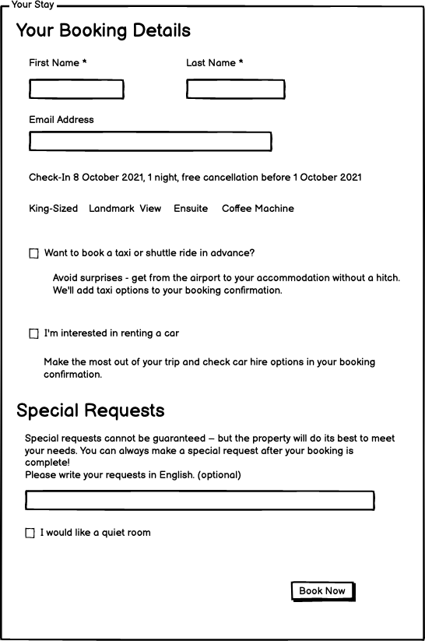
Task Based UI
A sequence of screens can build up a request
At this point, the user expects async
A sequence of screens can build up a request

Slide 114
Getting work done in a Monolith
{Get: Check-In Details}
API
Presentation
{Create Query}
Accounts
Housekeeping
…
Queries
Domain
ORM
{Query Accounts and Housekeeping using a join}
Data
Db
Notes:
Now, imagine we are building a good monolith. We might well have used CQRS. So instead of going through the Command Model, we are just going to query for the data we need, in the shape we need, from the database. (Let’s ignore for now, any complexity of whether we are reading the same rows as the Commands, or creating some projection based on their writes, the point remains the same either way, so let’s show it simply).
We can just query the database, and use a join to get the data we need. It’s all there. Querying for data to answer a query on an API is simple.

Slide 115
Partner
Client
Perimeter
Process Manager
API Gateway
Gateway
BFF
Direct
Bookings
Credit Card
Payments
Accounts
Housekeeping
Channel Manager
API
API
API
API
API
Db
Db
Db
Db
Db
Bus
Notes:
We can think about a microservice architecture as possessing a number of layers.
Client: Native, Web or User Agent, but also partner organizations using APIs from outside the perimeter
Perimeter: The line between internal and external systems
Gateway: A microservice is oriented around a business function, and owns its own data.
A lot of the time the microservice provides cross-cutting concerns such as authentication and TLS termination, but otherwise just acts as a proxy over the APIs
Sometimes we need to choreograph across multiple microservices
1: We need to combine data from multiple microservices to answer a query – API Gateway or BFF (client or partner specific)
2: We want to orchestrate the interaction of microservices to react to a command – Process Manager (also called a Saga or Orchestrator)
Microservices: A self-contained service that corresponds to a business process
Bus: Integration between microservices via a publish-subscribe model

Slide 116
Partner
Client
{GET: Booking Details}
Perimeter
{GET: 100ms}
Gateway
{GET: 100ms}
{GET: 100ms}
Direct
Bookings
Credit Card
Payments
Accounts
Housekeeping
Channel Manager
API
API
API
API
API
Db
Db
Db
Db
Db
Bus
Notes:
We can think about a microservice architecture as possessing a number of layers.
Client: Native, Web or User Agent, but also partner organizations using APIs from outside the perimeter
Perimeter: The line between internal and external systems
Gateway: A microservice is oriented around a business function, and owns its own data.
If we just want to get the customer booking details, it doesn’t seem so bad. Surely at this point, we can just grab the data from the backend services and merge it on the front end
The first problem is that the client needs to run the logic to interpolate the results. The second problem is latency again, particularly for mobile apps.

Slide 117
Check-In

Slide 118
Partner
Client
Perimeter
Process Manager
API Gateway
Gateway
BFF
?
Accounts
Housekeeping
API
API
Check-In
Db
Db
Bus
Notes:
Scenario: we want to retrieve the customer’s reservation details at the front desk. The front desk asks for the reservation, but we want to know some customer details if it is an account booking such as their name, credit card on file, preferences, rewards etc. But those live in the account system. How do we display them?
Do we need to call the accounts system as well as the housekeeping system?

Slide 119
Reference Data
GET /booking/12345 HTTP 1.1
Cache-Control: max-age=30
If-Modified-Since: Fri 19 April 2019 09:00 GMT
Pat Helland
Compatibility by Policy
Direct
Bookings
API
Outside Data
Services are Autonomous
Immutable, stale, versioned
Boundaries are Explicit
Single Writer
Db
Booking.Created.Event
Message-Id: aa95b387-a17f-4907-a1d8-e597c322bfc6
Correlation-Id: d060cb3f-ec71-4257-b5c8-819d1a9ca6cb
{ items : [Booking {…}]}
Inside Data
Share Schema not Type
Notes:
But we must share state in order to function – if no one talks to us we are not a microservice, we are just a small piece of standalone software
This is request-oriented or event-oriented e.g. we a REST API or events
Pat Helland calls the data that we are the system of record for Data on the Inside.
Helland calls the data that flows to other applications in this way, response or message body is Data on the Outside.
Data on the Outside risks being ‘stale’ as soon as we publish it. Any further changes to the Data on the Inside will render what we just published ’stale’.
Data on the Outside must be versioned or timestamped so that we know how ’fresh’ it is, and whether other data we have is newer or older.

Slide 120
Event Carried
State Transfer
GET /reservations/1234 HTTP 1.1
Martin Fowler
Accounts
Housekeeping
Web
Read Customer info
Operand Data
Worker
Read Reservation Details
Accounts Ref Db
Housekeeping Db

Slide 121
Channel Effectiveness

Slide 122
Partner
Client
Perimeter
Process Manager
API Gateway
Gateway
BFF
Direct
Bookings
Channel Manager
API
API
Channel Effectiveness
Db
Db
Notes:
Scenario: we want to combine referrer data from Direct Bookings with channel manager data about pricing, offers etc. to determine effectiveness of our channels

Slide 123
Event Carried
State Transfer
GET /channel/1234 HTTP 1.1
Martin Fowler
Direct Bookings
Channel Effectiveness
Web
Composite View Model/Historic Artefacts
Worker
Channel Manager
Read Effectiveness
Channel Effectiveness Db
Notes:
We can use a composite view model, building it from multiple events
Hint: This is what a Data Lake does, we can do it through the lake, or in some cases build our own model

Slide 124
Hotel Group Search

Slide 125
Partner
Client
Perimeter
Process Manager
API Gateway
Gateway
BFF
?
Direct Booking
Property Services
API
API
Group Room Search
Db
Db
Bus
Notes:
Scenario: we want to search across all our hotels, in a geographic region, such as a city, to look for available rooms at the time of the customer’s booking. If we can’t fit them in the budget hotel is their room in our upscale hotel?

Slide 126
Partner
Client
The Proxy provides a Composite API that our client code uses
We are using a ‘proxy’ to manage API calls
Process Manager
API Gateway
Gateway
BFF
Direct Booking
Property Services
A BFF is just a Gateway that is tailored to one client, over being generic.
API
API
Composition
Db
Db
Bus
Notes:
The composer is just a proxy. It may be on the server or the client. It exposes a shape of API itself. It combines the results of the underlying API calls.
On the server this is technically a Gateway. It can handle Retry/Circuit Breaker and observability
GraphQL may have a value here i.e. Apollo

Slide 127
Partner
Client
Process Manager
API Gateway
Gateway
BFF
Proxy can own retry/circuit breaker/rate limiting
Direct Booking
Property Services
On the server, it may provide cross-cutting concerns:
TLS termination
Authentication
…
API
API
Composition
May load balance over a group of instances for availability
Db
Db
Bus
Notes:
The composer is just a proxy. It may be on the server or the client. It exposes a shape of API itself. It combines the results of the underlying API calls.
On the server this is technically a Gateway. It can handle Retry/Circuit Breaker and observability
GraphQL may have a value here i.e. Apollo

Slide 128
8. Next Steps

Slide 129
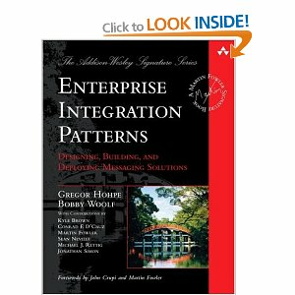
Further Reading

Slide 130
Q&A

